Slide 1

AMCAT EDA Project
By : Prabin Basyal

Slide 2
Introduction and Data Description
Objective:
A very raw description of the data set would be: One data set of employee records containing salary information, job description, education, and psychometric scores. The goals of this EDA are to:
Understand the structure of the data.
Identify patterns, trends, and relationships among features.
Test the hypotheses of salary variation across job roles.
Answer key research questions: such as salary range for fresh graduates, and the relationship between gender and specialization.
Data Summary:
Rows : 3998
Columns : 39

Slide 3
Introduction and Data Description
Data Description:
Provides candidate information including unique identifiers, annual salaries, job titles, locations, gender, and birth dates.
Academic data includes grades, school boards, college details, degree pursued, and specialization.
AMCAT test scores cover English, Logical, and Quantitative sections, domain module score, and engineering sections.
Personality test scores include Conscientiousness, Agreeableness, Extraversion, Neuroticism, and Openness_to_experience.
Geographical details include college city ID, tier, state, and graduation year.

Slide 4
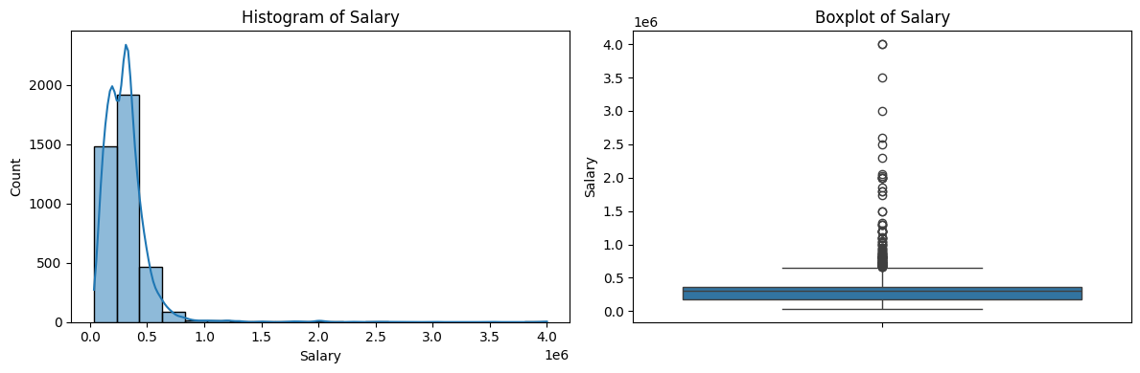
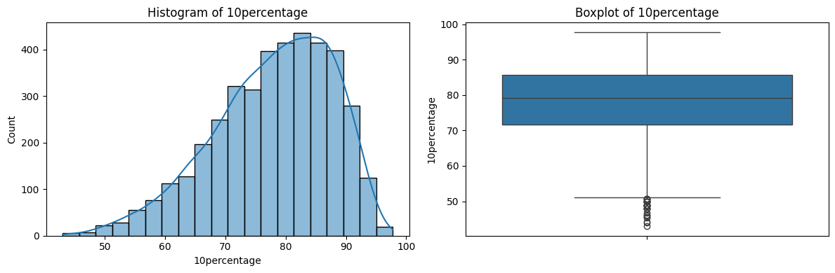
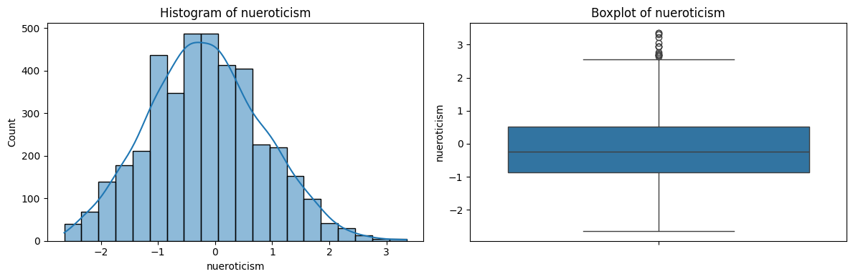
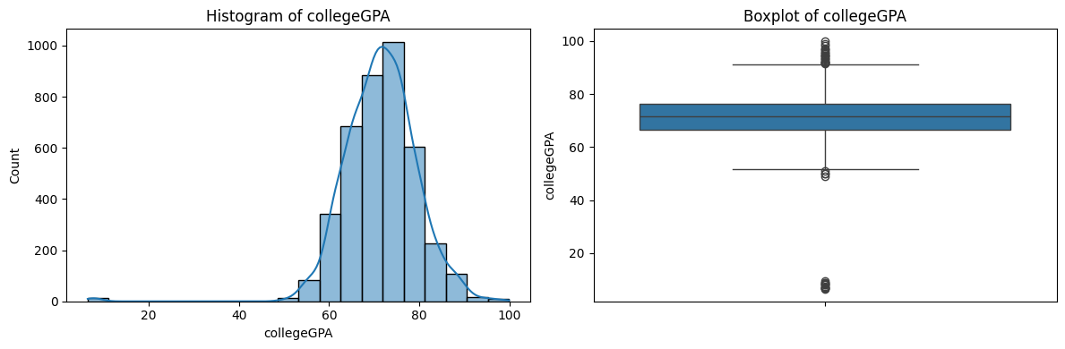
Exploratory Data Analysis
Univariate Analysis : Continuous Data

Slide 5
Exploratory Data Analysis
Univariate Analysis : Continuous Data
Observation:Salary Distribution
Statistical Analysis of Salary Distribution
Mean salary: 307,699
Median salary: 300,000
Salary range: 35,000-4,000,000
Standard Deviation: 212,737
109 outlier data present
Visual Analysis of Salary Distribution
Histogram and boxplot indicate skewed distribution
Further investigation recommended to confirm validity of high salaries.
Distribution is right skewed with minimal outlier data.

Slide 6
Exploratory Data Analysis
Univariate Analysis : Continuous Data
Observation: Educational Performance
10percentage : distribution is nearly normally distributed and there is large outlier.
12graduation : distribution is nearly normal distribution and have few outlier
12percentage : it has is normal distribution .
collegeGPA : it has is normal distribution with lots of outlier .
Here, we observe that as schooling progressed, the mean grade decreased.
Observation: Personality Attribute
Logical :it has is normal distribution with 18 of outlier.
Quant : it has is normal distribution with 25 of outliers.
conscientiousness : it has is normal distribution with lots of (39) outliers.
agreeableness: it has is normal distribution with lots of (123) outliers.
extraversion : it has is normal distribution with lots of (40) outliers.
nueroticsm : it has is normal distribution with few (15) outliers.
openess_to_experience : it has is left skewed distribution with lots of (95) outliers.

Slide 7
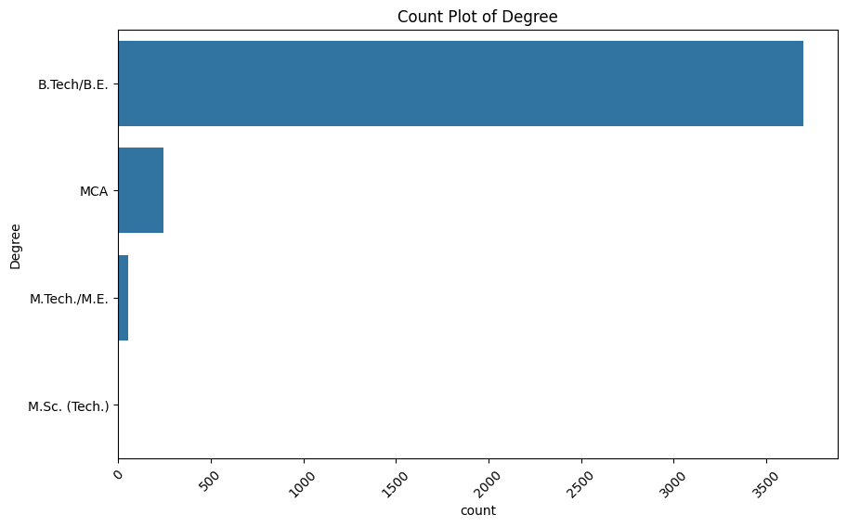
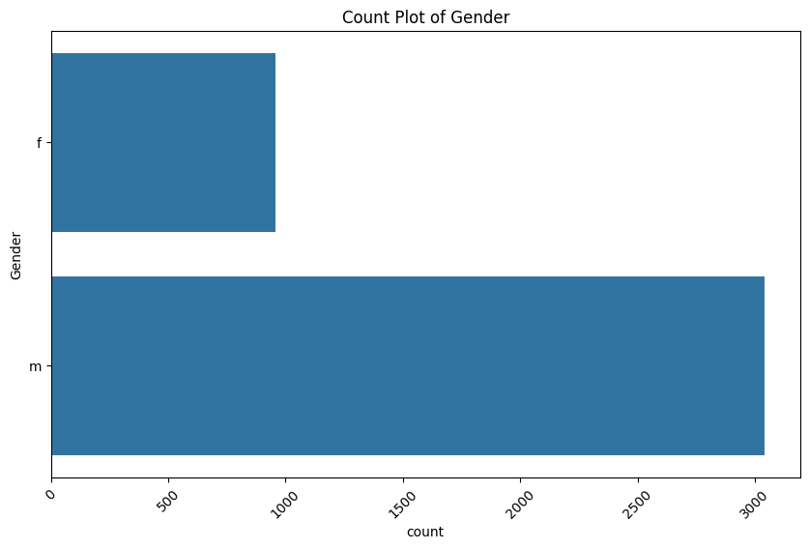
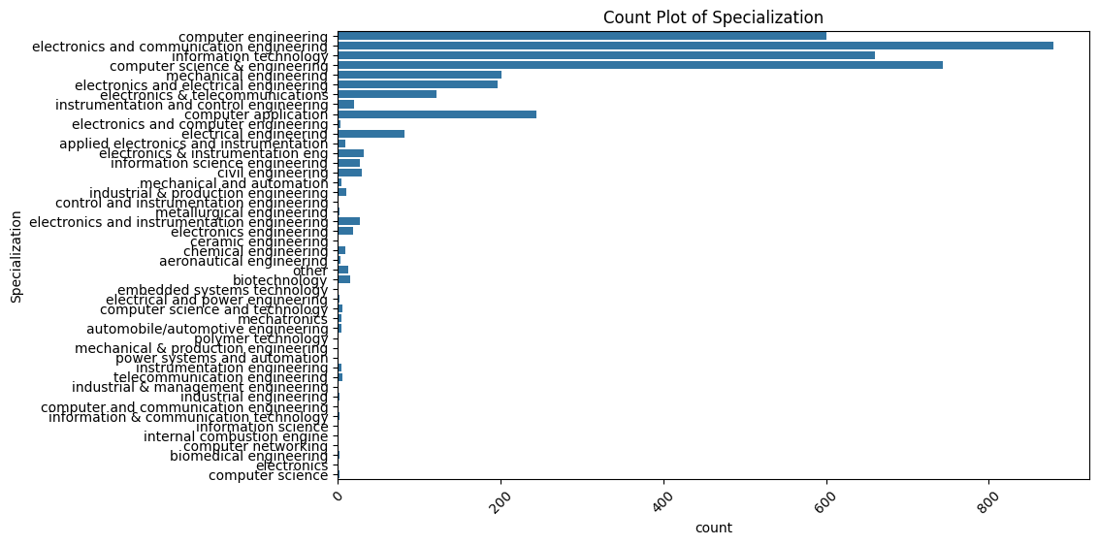
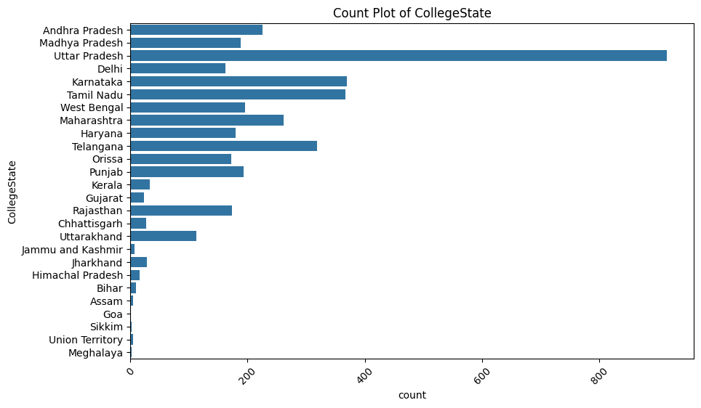
Exploratory Data Analysis
Univariate Analysis : Categorical Data

Slide 8
Exploratory Data Analysis
Univariate Analysis : Categorical Data
Observation: Gender Distribution
There are two gender (Male and Female).
About 23.9% of people are female, whereas the bulk of people (about 76.1%) are male.
Observation: Degree Distribution
The B.Tech/B.E., MCA, M.Tech./M.E., and M.Sc. (Tech.) are the four distinct degrees.
The most prevalent degree, accounting for almost 92.5% of the dataset, is "B.Tech/B.E." and 'M.Sc. (Tech.)' is lower, at 0.05%.
Observation: Degree Distribution
46 distinct specializations are available.
Specializations in "computer science & engineering," "information technology," "computer engineering," and "electronics and communication engineering" are the most popular.
The most popular specialization is "electronics and communication engineering," which is followed by "computer science & engineering" and "information technology."

Slide 9
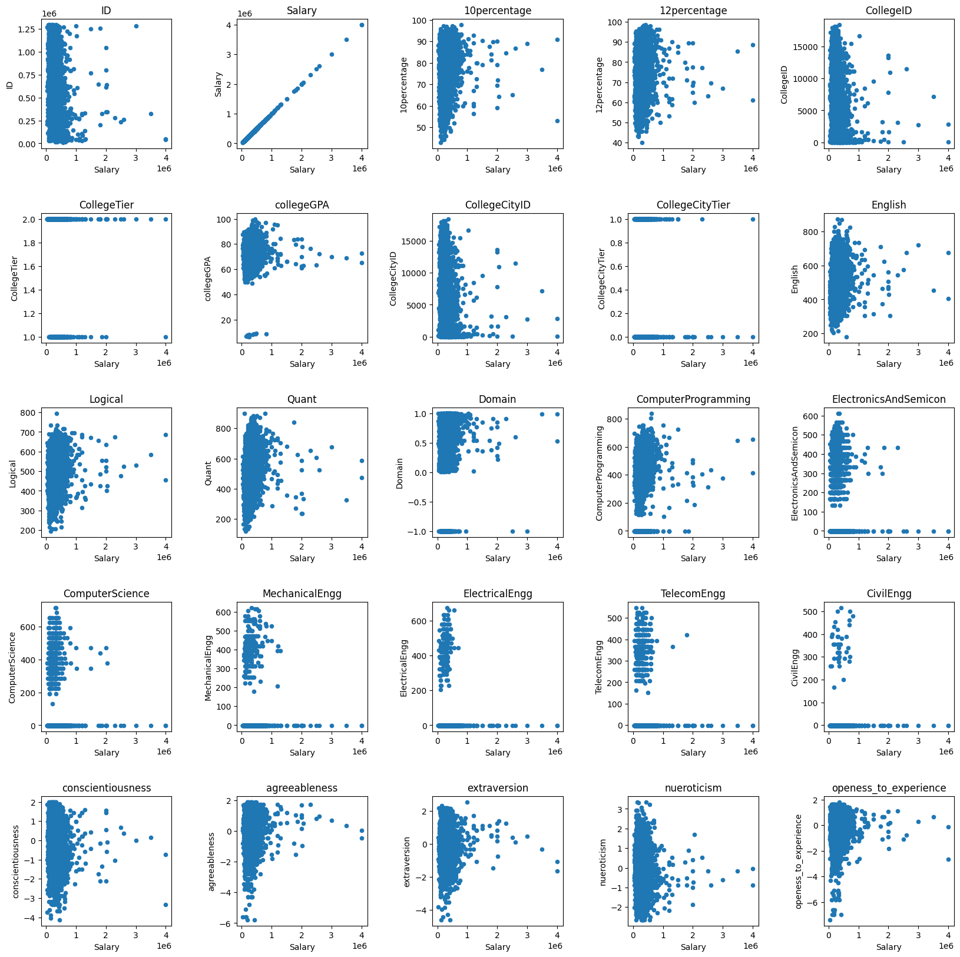
Exploratory Data Analysis
Bivariate Analysis : Relationships between numerical columns
Following is a brief interpretation of the results from the scatter plot between the columns Salary and other numerical columns:
There does not seem to be much relationship between the Salaries with 10th/12th percentages; early academic excellence does not seem to have a telling impact on salary expectations in the job market.
A slight positive trend might be present between Salary versus Degree percentage, which indicates that the students performing better in their degree programs have a slightly better salary, though the impact isn't strong.

Slide 10
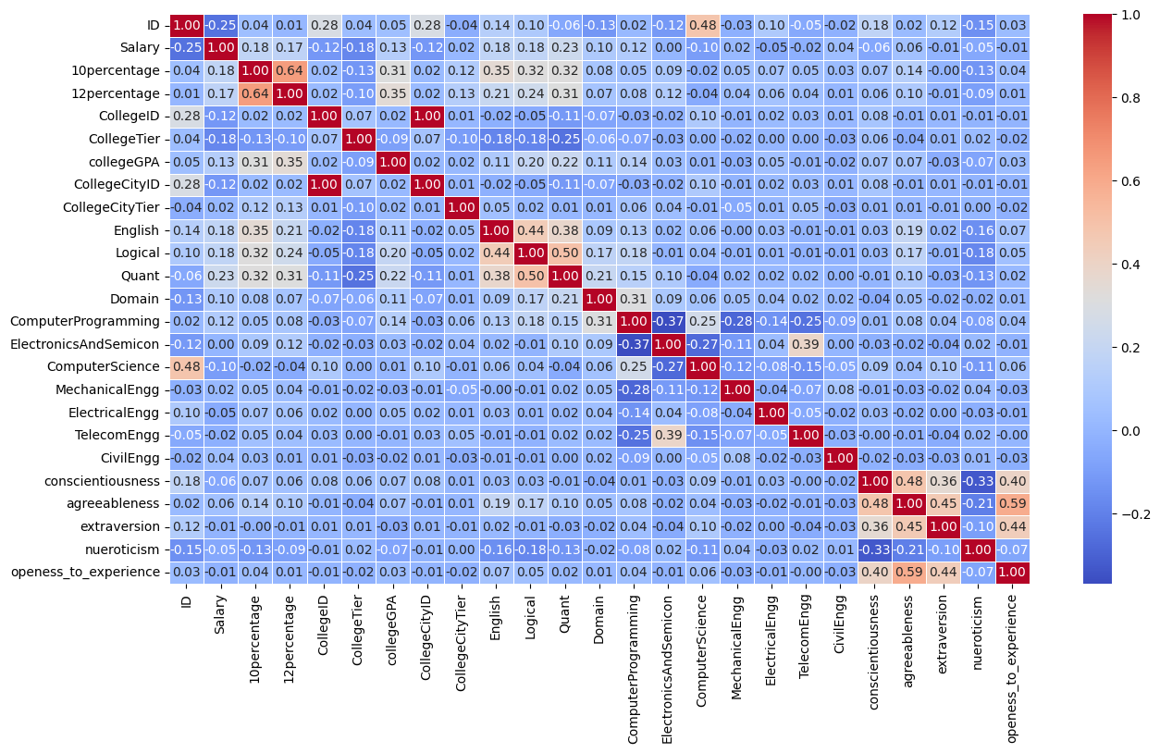
Exploratory Data Analysis
Bivariate Analysis : Relationships between numerical columns
There is a better relationship between Salary and MBA percentage; that means performance in the MBA program may directly influence job roles or salaries among the candidates, marking the importance of postgraduate education.
The outliers in the scatter plots represent a specific number of workers whose wage is significantly higher or lower compared to other workers of their caliber with similar academic performances. This indicates that other determining factors besides grades play a vital role, such as their work experiences or types of industries they work within.
On the whole, academic performance isn't a very great predictor of salary in each and every case, especially in the case of 10th and 12th grades. This would, in turn, suggest that salaries could be better linked to job experience, certain skill sets, industry, or even location.
Scatters would also most likely hint that the large bulk of wages falls within a particular range, which should, alone, support the fact that academic performance cannot be the only determinant of the variation in wages.

Slide 11
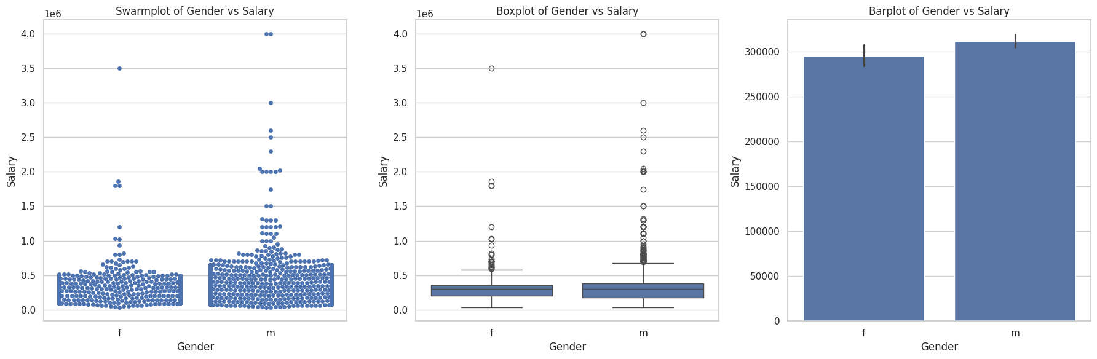
Exploratory Data Analysis
Bivariate Analysis : Continuous Numerical vs Discrete Data

Slide 12
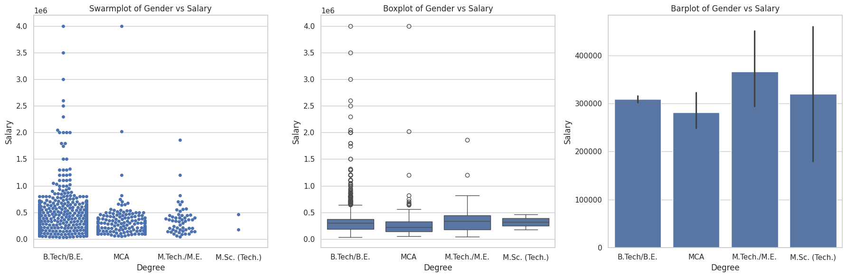
Exploratory Data Analysis
Bivariate Analysis : Continuous Numerical vs Discrete Data
Observation:
Gender vs Salary indicate a small gender pay gap but it is not that much different.
the structure is repeated in the swarm, box, and bar plots-the fact that some fields tend to get paid higher. Some degrees showed greater salaries dispersion, which reflects career paths and opportunities that are pretty diverse. It includes people receiving much higher or much lower salaries compared to people within the same major degree.

Slide 13
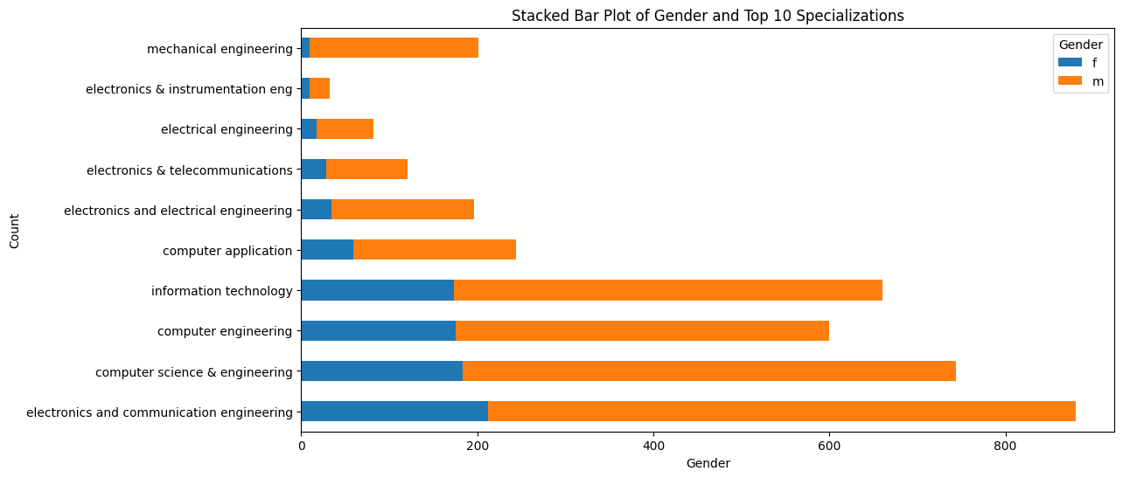
Exploratory Data Analysis
Bivariate Analysis : Relationships between categorical and categorical

Slide 14
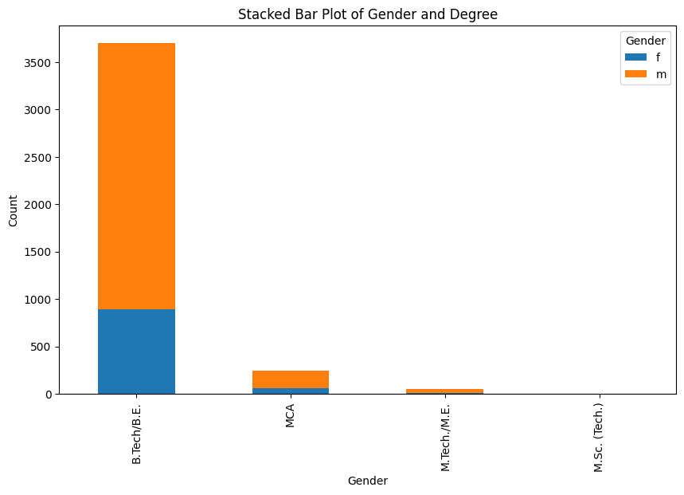
Exploratory Data Analysis
Bivariate Analysis : Relationships between categorical and categorical
Observation:
Both gender most of students take B.TECH./B.E. as a degree
In electronics and communication engineering high involvment of both gender(male generally are more than female). By looking at above plot we can see males are doing more specialization than females.

Slide 15
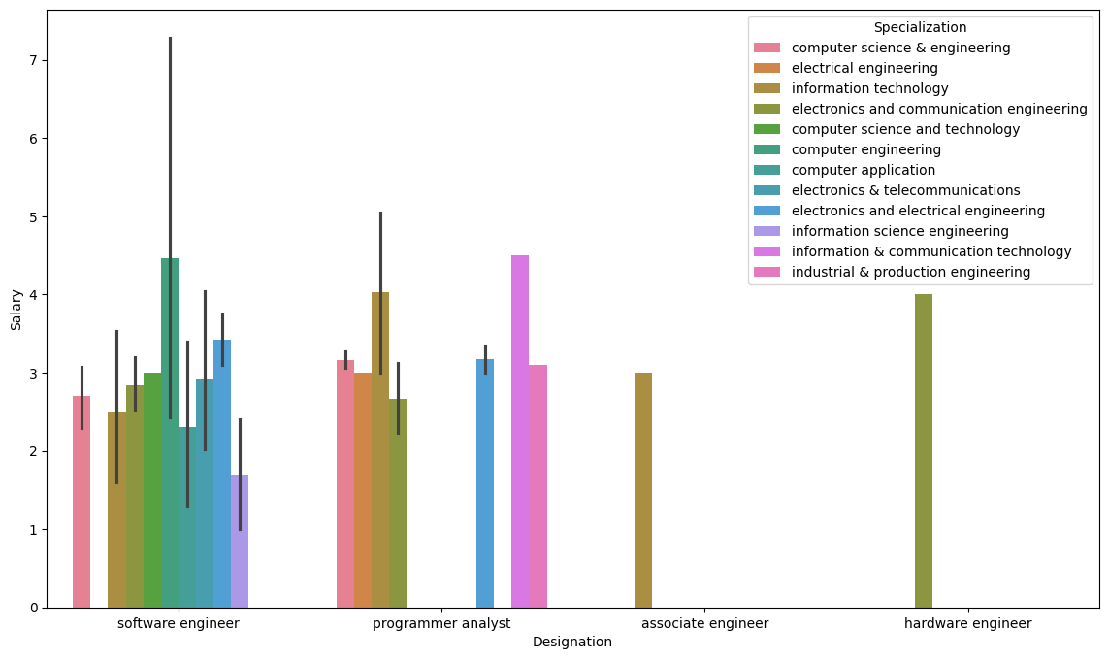
Research Questions
CLAIM-1 : Times of India article dated Jan 18, 2019 states that “After doing your Computer Science Engineering if you take up jobs as a Programming Analyst, Software Engineer, Hardware Engineer and Associate Engineer you can earn up to 2.5-3 lakhs as a fresh graduate.” Test this claim with the data given.

Slide 16
Research Questions
CLAIM-1 : Observation
Barplot indicates that the Programming Analysts, Software Engineers (Exclude Information Science Engineering), Hardware Engineers and Associate Engineers can have an amount as large as 2.5-3 lakhs when they graduate afresh.
CLAIM-2 : Is there a relationship between gender and specialization? (i.e. Does the preference of Specialisation depend on the Gender?)
Observation:
Here I use the Chi-Squared Test with the aim of finding if there is any relationship between gender and specialization.
We obtain the result: Reject the null hypothesis. There is a significant relationship between Gender and Specialization.

Slide 17
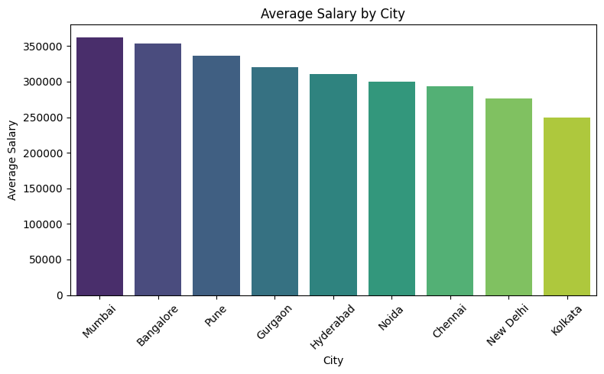
Bonus
Do specific cities offer higher-paying jobs?
Observation:
This bar plot will show which cities have higher average salaries. It is assumed that cities with strong economic or tech industries, capitals, or metropolitan areas are most likely to show higher average salaries.
Also use ANOVA Test,where the p-value from the ANOVA test is less than 0.05, there are salary differences across cities that are statistically significant. So, location may be important in salary determination.

Slide 18
Conclusion
Salary Distribution
Mean salary is 307,699, median salary is 300,000.
Salary ranges from 35,000 to 4,000,000.
Standard Deviation is 212,737, indicating wider salary dispersion.
109 outlier data present in salary.
Specializations
Most popular specializations are "electronics and communication engineering."
No significant relationship between salaries with 10th/12th percentages.
Salary versus Degree percentage shows a slight positive trend.
Better relationship between Salary and MBA percentage suggests performance in the MBA program may directly influence job roles or salaries.
Personality Attributes
Conscientiousness, agreeableness, extraversion, neuroticism, and openness to experience are measured on scales with different ranges.
Gender vs Salary
Small gender pay gap, but not significantly different.
Some fields tend to get paid higher.
Programming Analysts, Software Engineers, Hardware Engineers, and Associate Engineers can earn up to 2.5-3 lakhs when they graduate afresh.
Significant relationship between Gender and Specialization.

Slide 19

THANK YOU

